Slide 1


Random Game!
To win this game you have to find Waldo ;) Good Luck
Click here To Continue

Slide 2
INSTRUCTIONS
Do not click unless you are told to, this game will move freely and any clicking will change the course. The instructions are simple, find Waldo and you win the game. Be careful, because we all know how tricky that son of a bi- I’m mean, Waldo can be. ;)

Slide 3




Click on a box to Click a Level
More

Slide 4
One of these fireworks contains Waldo!! Which one is it? :]

Slide 5
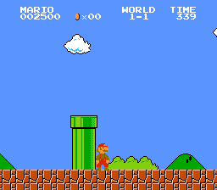
Click here to go back

Slide 6
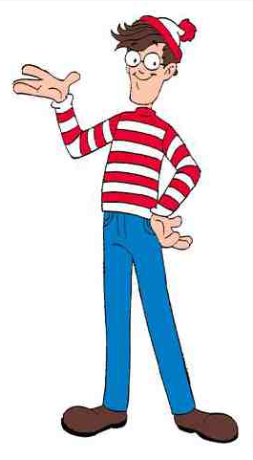
Good Job!!!
Next level?

Slide 7

W
H
R
E
E
?
Which apple holds Waldo inside?
?
I
S
?
W
A
L
D
O

Slide 8
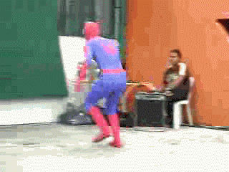
Try again?

Slide 9


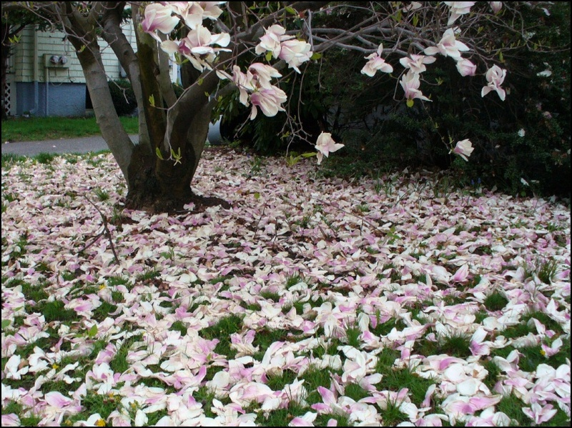

Click on a box to Click a Level
Back
Credits

Slide 10



Where is Waldo hiding?

Slide 11
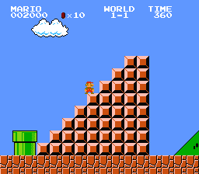
Try again?

Slide 12




Waldo likes smelling flowers,
Where do you think he is?

Slide 13

Try again?

Slide 14
End
Back
Credits
Dare- by Gorrilaz
“Waldo” jpg.
Creator: Jan

